Slide 1
Youth Development Plan
2013 – 2015

Slide 2
What is the Trust’s Youth Work project all about?
Youth Focussed Projects
After school learning
Games
Technology
Inspiring young people through our careers event
Listening to the Community
Supporting Youth Group volunteers
Sport
Activity Agreements
Filling gaps
Working with our Young People
Hosting Fun activities
Creating new opportunities for our young people
Helping new groups get started up
Linking up with other Communities
Dance and Music
Developing our young people
Cooking
Developing our volunteers through training and encouragement

Slide 3
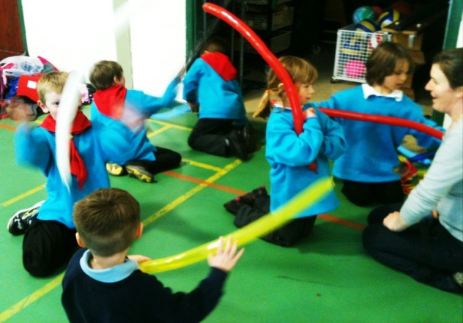
What is the Trust’s Youth Work program all about?
The purpose of our roles is to develop and support the young people on Tiree by assisting local youth groups, creating new opportunities and experiences for young people, encouraging and organizing training for volunteers and keeping the community informed as to what the young people are doing.
"We value our young people and see them playing a lead role in the future of the island. We must ensure that any development improves and increases facilities, employment and services for young people and children, and seek to involve them in decision making affecting their future.” Tiree Community Growth Plan

Slide 4
Year 1 - 2009-2010
Trial year for this post
Working with 4 existing groups
Professional golf tuition visit
- Extensive consultation with young people done
Chat Room was initiated and opened
Beauty workshops
Street Dance workshops
Beginnings of Duke of Edinburgh
A and B sexual health forum group
Young Farmer’s group was set up
Spoke at FAB conference in Oban

Slide 5
Year 2 - 2010-2011
Three year position now funded by Robertson Trust
- Now working with 7 existing groups and 2 new groups
Karate weekend with Young people from Coll
Led team building day at Tiree High School
Chat Room Developed
Eco drama recycling workshops
Worked with Regatta to provide sailing tuition
Beginnings of Beaver Scouts
Co-ordinated first aid training for volunteers
Child Protection and Child Development training on Tiree
Junior Membership at the Trust
Facilitated at Oli conference in Oban

Slide 6
Year 3 – 2011 - 2012
Now working with over 100 young people on Tiree
Working with 9 voluntary led Youth Groups
37 Adult Volunteers working with youth groups
Beaver Scouts now running smoothly
Careers Event in May
School café and Mug painting project
Power kiting for teenagers
Sailing summer event
Play Park Mosaic Project
Sexual Health Awareness event
Graffiti workshops
Secured over £9,000 of funding for various projects
Skate Park working group set up
Presentation at DTAS Conference
National Youth Worker of the year for Scotland
Various training courses on Tiree for volunteers
National Youth Work Week Extravaganza
Funding for Sessional Youth Worker secured

Slide 7
Year 4 – Jan 2012 – Dec 2013
Now working with over 100 young people on Tiree
Working with 9 voluntary led Youth Groups throughout the year
37 Adult Volunteers working with youth groups
Youth Development Plan created
Sessional Youth worker employed
Communication methods with young people improved
Annual Careers Event in May 2013
Sessional Youth worker assisted on P7 School Trip
Dance Directionz Developed
Interisland Football Event Summer 2013
Archery on Tiree and Coll Summer 2013
Assisted at swim week
School café project and 30 minute sessions running weekly
Stramash sailing summer event
Skate Park working group set up
Hebridean Food Festival September 2013
National Youth Work Week (Story teller, DJ workshops)

Slide 8

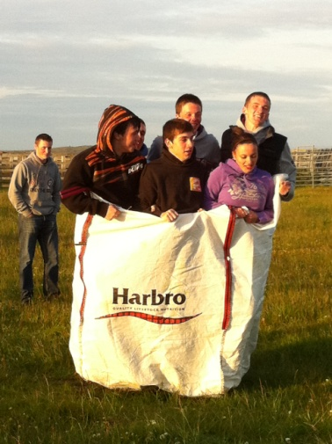
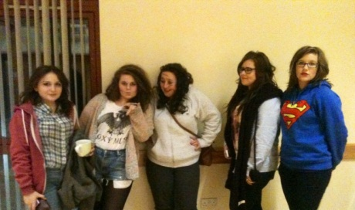

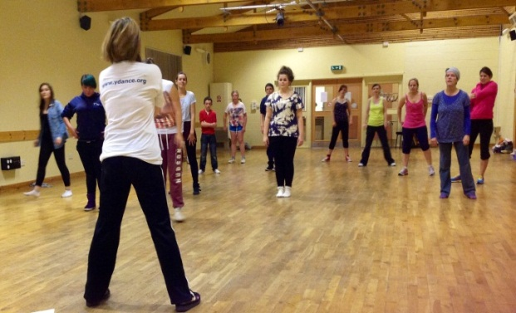
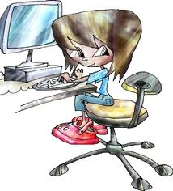

What do we actually do each day?
Working with Youth groups – Supporting volunteer-led youth groups with hands-on help, running activities and games, advice, admin support and organizing meetings or training.
Planning! With everything we’re involved in we have to plan our time carefully. We use weekly plans, rotas, budgets as well as planning new games and activities to ensure there is never a dull moment!
Coordinating
Training for volunteers
Creating opportunities- Each year we organise training workshops and events which would not usually be available to young people on Tiree.
Projects – Work on Youth focussed projects . Applying for funding and co-ordinating working groups.
Keeping the community in the loop – Using the Trust website and local newsletter the community is informed about everything which is going on with our project!

Slide 9
Youth Group leader’s Comments of the Tiree Trust Youth Work project and Assistance so far…
“We are very appreciative of all the help Sophie has given us which has been invaluable - just need more!” – Tiree Windsurfing Club
“Yes Sophie is a huge help to our team as she is committed to our group and helps with singing/music and building relationships with kids and parents.” - Mainly Music
“Yes, Sophie attends on regular basis as a Leader and helped bring group together and facilitated start up of group.” - Beaver Scouts
What more do the Youth Group leaders want to see from the Tiree Trust Youth Work Project?
“Help to provide office bearers and encourage more children to come..” Tiree Duke of Edinburgh
“Just continue supportive role shown at present.” Mainly Music
“Keep going with activities that have been successfully set up and add opportunities for teenagers” Tiree Beaver Scouts
“Just more of the same - more time” Tiree Windsurfing Club

Slide 10
Results from Youth Consultation
What do you see as the biggest issues on Tiree at the moment?
Finding long-term housing Affordable Housing
Sustainable employment Number of pupils in the school
Transport Further Education options
Number and choice of subjects in the School Reliability of the Broadband
If you had a magic wand, what would you like to see happen on Tiree?
Custom made Youth Building New School
Gym Road surfaces improved
Motor Cross track Swimming Pool
More people
What Youth Activities would you like us to investigate and potentially organise this summer?
Archery Paintballing
More Street Dance Cookery workshops
Rugby – tuition and tournaments Juggling / circus skills
BMX workshops / skills Martial Arts
Jewellery making Power Kiting
Beauty / make-up / shopping outlet development Beach volley ball tournament

Slide 11
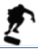
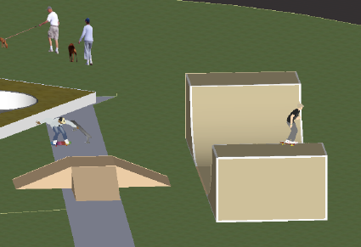


A Vision For the future
Tiree Adventure Park Project
Developing continued learning on Tiree

Slide 12
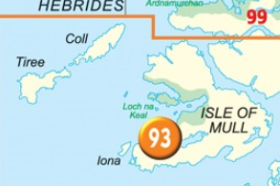


A Vision For the future
Inter-island working
Tiree Cub Scouts
Creating healthy lives

Slide 13


A Vision For the future
Continue Annual Careers day
Fresh Fridays Teen’s sports club set up!

Slide 14
Our Targets for the next three years
Work with the FGO to set up a code of conduct, processes and structures for a smooth, safe and professional Youth Work Department
To continue working with Young people on Tiree and Coll on our Creating Opportunities project to increase learning, fun and activities for young people. This project includes National Youth Work week events.
To continue supporting and developing existing Youth groups on Tiree
To work with the Swimming group and the sailing group to get both projects off the ground over Winter 2014/15
To develop our Creating Happy Volunteers Project by continuing to co-ordinate training, PVG assistance and volunteer appreciation ideas on Tiree.
Work alongside the steering group on Tiree Adventure Park Project
Creating stronger links and relationships between Islands
Develop our Creating Skilled Young people Project by continuing to hold our annual Careers event each Spring and to continue running our careers mentoring and activity Agreements projects.
Develop our Creating Healthy Lives project by providing cooking lessons and increased sports opportunities. (FRESH FRIDAYS)

Slide 15
Timeline for targets
March 2014
April 2014
May 2014
June 2014
July 2014
AUG 2014
Youth workers assisting all groups on a weekly basis.
Launch of Fresh Fridays?
First Aid Training on Tiree
- Youth workers assisting all groups on a weekly basis. (Windsurfing Club begins)
Youth workers assisting all groups on a weekly basis.
Launch Cubs?
Community Open Day
- Youth workers assisting all groups on a weekly basis.
Interisland Summer Program running
- Youth workers assisting all groups on a weekly basis. (fewer groups)
TMF Common Wealth Games Event Interisland Summer Program running.
- Youth workers assisting all groups on a weekly basis. (fewer groups)
Interisland Summer Program running. Volley Ball Event
SEP 2014
Oct 2014
Nov 2014
Dec 2014
Jan 2015
Feb 2015
Youth workers assisting all groups on a weekly basis.
Food Festival Event
- Youth workers assisting all groups on a weekly basis.
Youth workers assisting all groups on a weekly basis.
National youth Work Week
- Youth workers assisting all groups on a weekly basis.
- Youth workers assisting all groups on a weekly basis.
- Youth workers assisting all groups on a weekly basis.

Slide 16
How do these targets fit with youth work on a national level?
Government Aims for Youth Work - SCOTLAND
A wide range of activities - These include training and awards programmes, literacy projects, outdoor education, volunteering opportunities, community activities, anti-violence and anti-sectarianism initiatives, healthy living programmes and sports, arts and cultural activities.
Champions of young people - We want to support the thousands of dedicated champions of young people. In particular those volunteers who give up their precious time to invest in young people's future and in doing so build on their own skills.
Building young people's skills - Youth work opportunities provide lots of opportunities for young people to learn. To develop confidence and foster creative thinking. To acquire leadership and negotiation skills and learn to problem solve. To work well with others and to build teams. These are some of the skills that employers are calling out for.

Slide 17

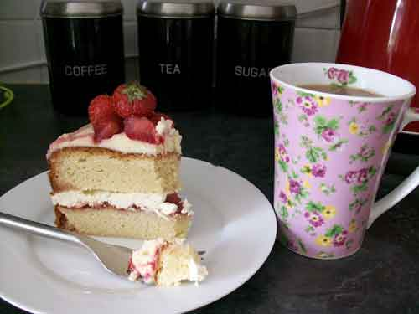
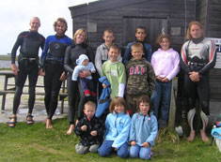
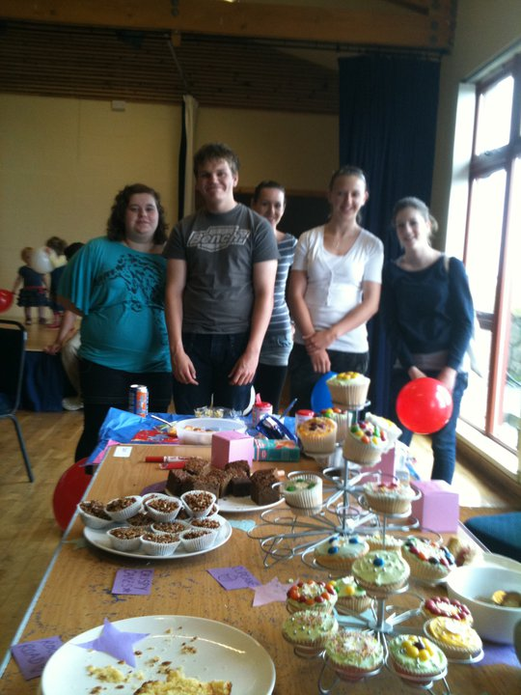
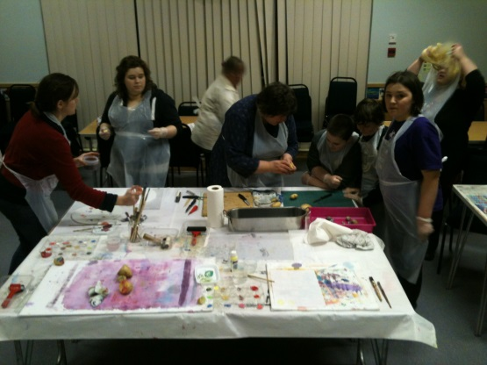
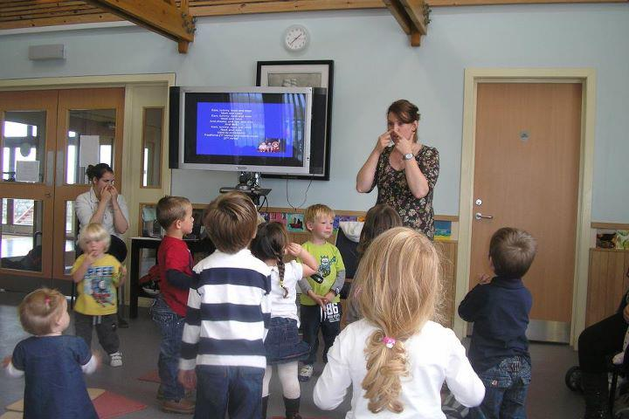
On the following slides are details of all of the different groups we are currently assisting on the Isle of Tiree
Youth Groups we are currently working with…

Slide 18
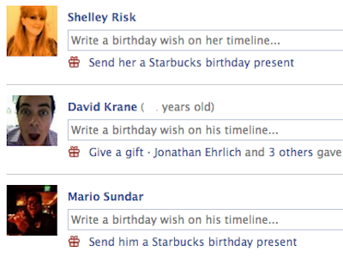
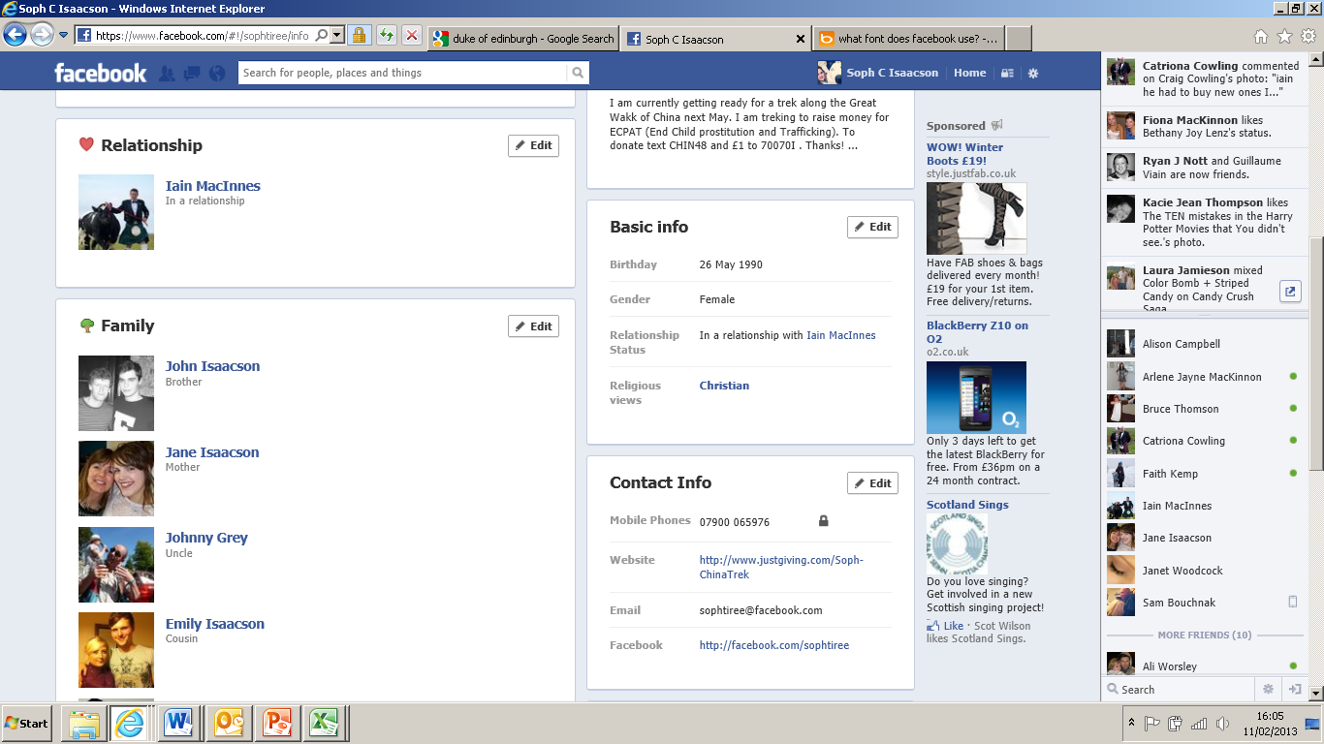
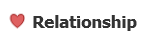

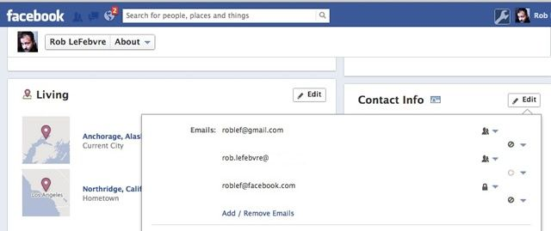
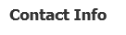
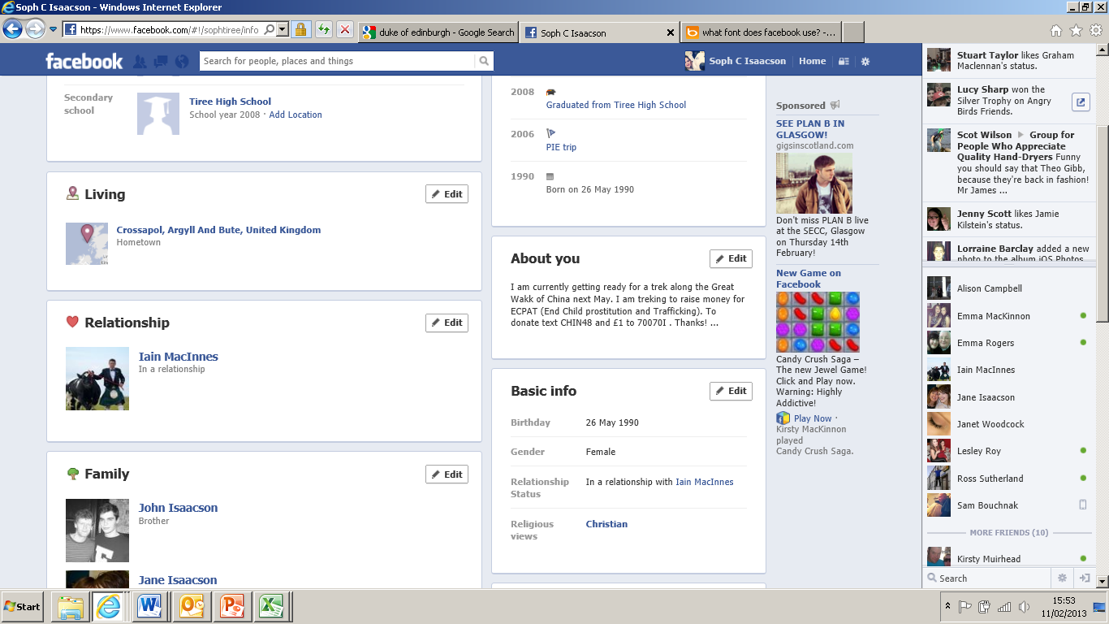


Y
outh Work Tiree – Youth group Profile Pages
22nd August 2010
In a relationship with Tiree Trust Youth Work Project
Catriona Spink, catriona.spink@me.com
Youth Group Name:
Number of Adult Volunteers:
Age Range of group:
Number of Young people who attend:
What Happens at the Group:
Future hopes and dreams of the group:
Duke of Edinburgh
6
14-25
10
To build up their own skills in physical activity (promoting health and wellbeing) and to encourage personal skills , volunteering , teamwork and improving confidence
To build on what we are already doing and get the kids through their bronze award then begin silver .To encourage more team events improving the local community

Slide 19

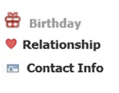

Y
outh Work Tiree – Youth group Profile Pages
18th February 2012
In a relationship with Tiree Trust Youth Work Project
Fiona Armstrong, fiona.armstrong1@btopenworld.com
Youth Group Name:
Number of Adult Volunteers:
Age Range of group:
Number of Young people who attend:
What Happens at the Group:
Future hopes and dreams of the group:
Tiree Beaver Scouts
10
5 to 8 years
22
Scouting Association activities, Arts and Craft, New skills, learning re. particular themes, team games, ethos of fun and co-operation.
Group started just over year ago and is successful. Keep going with activities that have been successfully set up and add more opportunities for teenagers.

Slide 20

Y
outh Work Tiree – Youth group Profile Pages
September 2011
In a relationship with Tiree Trust Youth Work Project
Tiree Trust Workers lead this
Youth Group Name:
Number of Adult Volunteers:
Age Range of group:
Number of Young people who attend:
What Happens at the Group:
Future hopes and dreams of the group:
School Cafe
3
16 – 18 years
8
The young people can come into the café on Wednesday lunchtimes and relax, chat to each other and the leaders, drink tea and eat cake.
Group started just over year ago and is successful. We have run mug painting activities and are given magazines by Macleods for the young people to read. Good connection between the Church , the youth project and the young people.

Slide 21

Y
outh Work Tiree – Youth group Profile Pages
18th April 1994
In a relationship with Tiree Trust Youth Work Project
Lorna Macdonald, lorna.tiree@live.co.uk
Youth Group Name:
Number of Adult Volunteers:
Age Range of group:
Number of Young people who attend:
What Happens at the Group:
Future hopes and dreams of the group:
Tiree Water Sports Club
4
6-18
14
Water Play, Balance on the water, windsurfing skills, swimming skills, body boarding , SUPing
To build on what we are already doing. Look into introducing new aspects to the club like SUP or surf.

Slide 22

Y
outh Work Tiree – Youth group Profile Pages
18th April 2008
In a relationship with Tiree Trust Youth Work Project
Ishbel Campbell, 220045, ishbelcampbell7@hotmail.com
Youth Group Name:
Number of Adult Volunteers:
Age Range of group:
Number of Young people who attend:
What Happens at the Group:
Future hopes and dreams of the group:
Mainly Music
12
0 - 5 years
20-30
30 minute music session / snack / play
To continue with a steady number of families coming along and enjoying the interaction and music of the sessions.

Slide 23
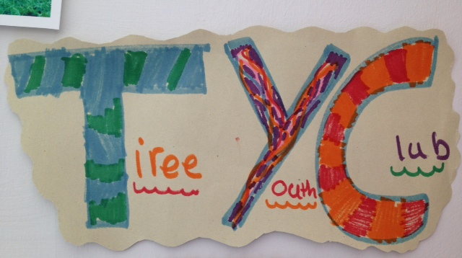
Y
outh Work Tiree – Youth group Profile Pages
18th April 1995
In a relationship with Tiree Trust Youth Work Project
Margaret Worsley , 220317
Youth Group Name:
Number of Adult Volunteers:
Age Range of group:
Number of Young people who attend:
What Happens at the Group:
Future hopes and dreams of the group:
Tiree Youth Club
6
8 – 14 years
20
Mondays , Wednesdays and Fridays
Games, sweeties, arts, competitions.
To continue with a steady number of children attending. Improve facilities and equipment. To develop competitions , activities and fun.

Slide 24
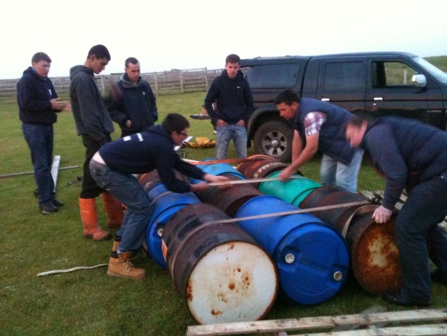
Y
outh Work Tiree – Youth group Profile Pages
18th April 1995
In a relationship with Tiree Trust Youth Work Project
Iain MacInnes, 220504
Youth Group Name:
Number of Adult Volunteers:
Age Range of group:
Number of Young people who attend:
What Happens at the Group:
Future hopes and dreams of the group:
Tiree Young Farmers
5
14 - 30 years
22
Meeting once a month.
To continue with a steady number of Young Farmers attending. To go to the Royal Highland show for a visit in June.

Slide 25
Youth Work Tiree – What are our Strategic Themes?
In other words.. What are we working towards?
1. Creating Opportunities
2. Creating Healthy Lives
3. Creating Skilled Young Adults
4. Creating Happy Volunteers
5. Creating Infrastructure

Slide 26
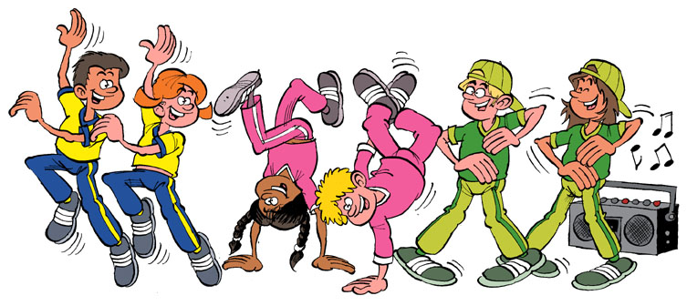
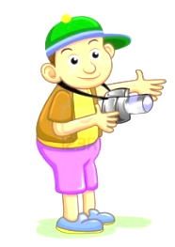




1. Creating Opportunities
Activities, groups, workshops and events which are not readily available to young people on Tiree due to our remoteness. All ideas come from consultation with young people.
Projects include:
Summer Program of activities
To assist with the Start-up and development of a new Cub Scouts group for children leaving Beaver Scouts.
National Youth Work Week

Slide 27
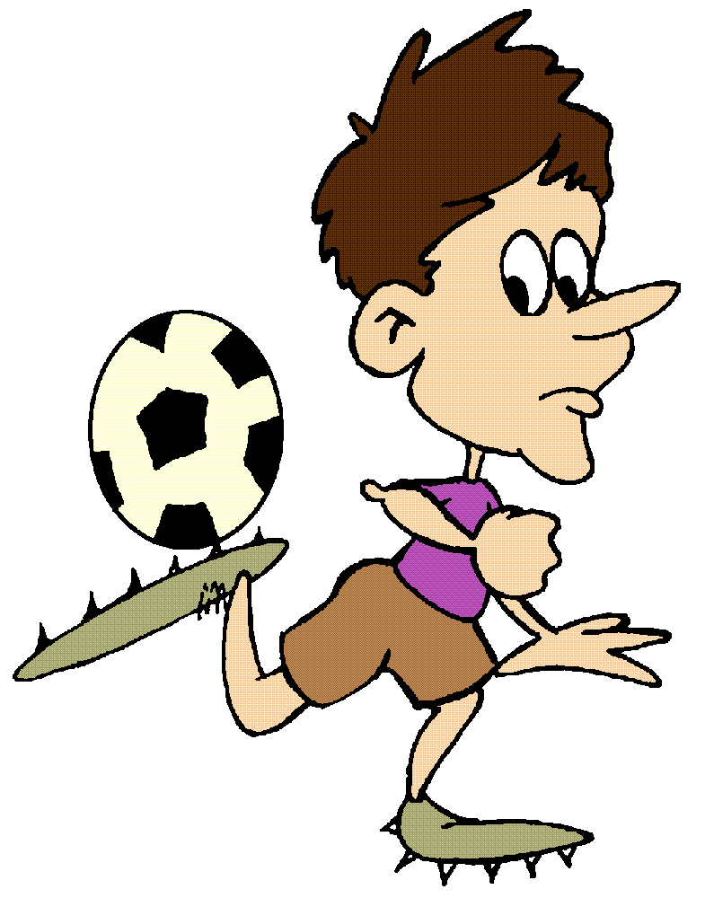

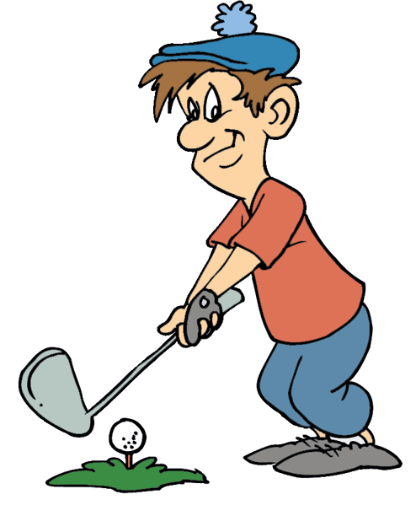
2. Creating Healthy Lives
Development of Sports, Tiree Freestyle Park Project, Scarinish Adventure Play Park Project, Interisland tournaments and focus on healthy eating and nutrition education.
Projects include:
Interisland Sporting Events
Dance Directionz Start-up
Tiree Adventure Park Project
Interisland Healthy Eating Event

Slide 28
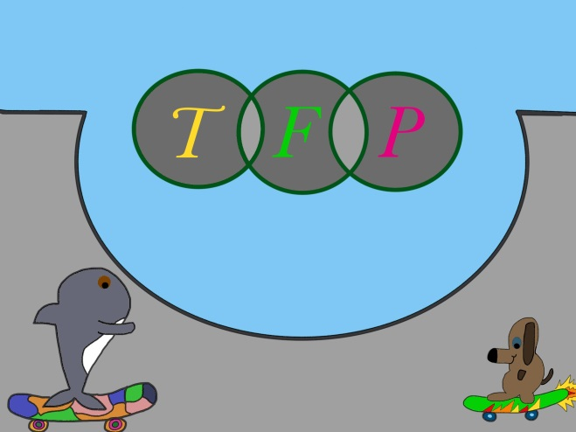


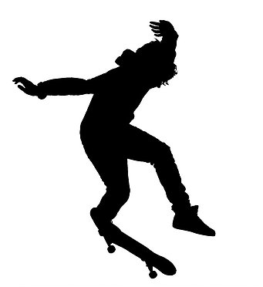
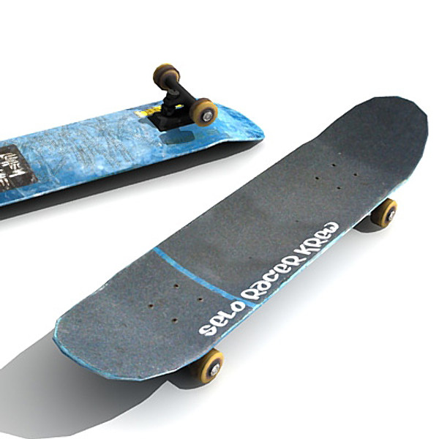
2. Creating Healthy Lives
Tiree Freestyle Park Project
Freestyle Park in Crossapol including a launch event for the park, skate boarding tuition, demos and workshops. All led and co-ordinated by the Tiree Freestyle working group which is chaired by Jack Straker and Finn MacDonald and is supported by Sophie Isaacson and Lynn Cox

Slide 29

2. Creating Healthy Lives
Tiree Adventure Park Project
This project is to develop a second outdoor play area on Tiree. This play area will be in Scarinish as there are many young people living in that area and no provision for a safe, outdoor are to play in. This project is at the early stages of development and is being supported by Sophie Isaacson and Lynn Cox.

Slide 30


3. Creating Skilled Young Adults
Careers Event, Skills mentoring, C.V workshops and promotion of courses and learning on Tiree
Projects include:
Annual Careers Event
Careers mentoring
Activity Agreements

Slide 31



4. Creating Happy Volunteers
Volunteer training and appreciation to ensure our volunteers feel comfortable and happy with the roles they are in.
Projects include:
Training for Youth Volunteers
Volunteer Appreciation

Slide 32

5. Creating Infrastructure
Setting up a code of conduct, processes and structures for a smooth, safe and professional Youth Work Department.

Slide 33
Other Ideas for developing quality of life for young people on Tiree… from consultation
More indoor opportunities for children to exercise i.e leisure centre and swimming pool
Dance / sport classes for children
Hockey
Need for all children to have opportunity to be active and opportunity for team games to bring children together in positive way, but they need structure and direction from adults.
Team sports between islands.
Netball
Develop Dark Skies Group
Swimming on island.
Athletics/cycling club
Golf
Football
Badminton
Kayak club
Encourage knowledge of the environment. Get kids outside
Short term workshops eg. Astronomy, birdlife

Slide 34
The youth is the hope of our future.

